Slide 1
WHAT IS
GOOD
WRITING?
Assessing the Pilot of a Standardized Curriculum for Better Benchmark Performance in First-Year Composition
Dr. Elizabeth F. Chamberlain
Director of First-Year Writing

Slide 2
17 faculty members
~50 sections/semester
~1800 students/year
teaching Composition I and II in AY2019-20
with more Comp I in the fall, more Comp II in the spring

Slide 3
2012-2020
PROGRAMMATIC REORGANIZATION
new director of composition
standardization of assignments
director of composition left
division into director of composition & director of the writing center
curriculum pilot

Slide 4
problem
1:
TERRIBLE
INTER-
RATER
RELIABILITY
which meant our assessment data wasn’t
statistically valid

Slide 5
problem
2:
INCONSISTENT
IDEAS
ABOUT WHAT
MAKES
WRITING GOOD
i.e. it wasn’t just a data problem

Slide 6
problem
3:
SO
MUCH
REINVENTING
THE WHEEL
because faculty didn’t have shared strategies

Slide 7
SUMMER 2018 CURRICULUM PILOT
Eight composition faculty met through June to redesign our Comp I & Comp II curriculum.
Developed new assignment sequences & wrote new prompts and rubrics
Rewrote
Student Learning Outcomes
Brainstormed assessment processes

Slide 8
MULTIMODAL
we wanted the new curriculum to be

Slide 9
DISCIPLINARY
we wanted the new curriculum to be
(and interdisciplinary)

Slide 10
PROCESS
we wanted the new curriculum to emphasize

Slide 11
NEW STUDENT LEARNING OUTCOMES
GENRE
COMMUNITY
RESEARCH
CITATION
REVISION
METACOGNITION
GRAMMAR
Evidence of experimentation with genre conventions in various rhetorical situations, modes and technologies.
Evidence of engagement with larger ongoing civic, social and academic conversations.
Evidence of disciplinary and professional research.
Evidence of revision based on feedback.
Evidence of effective rhetorical choices regarding grammatical and stylistic conventions.
Evidence of understanding of intellectual property, with an emphasis on standardized citation styles.
Evidence of metacognition and reflection on writing and writing processes.

Slide 12
Composition I
No standardized curriculum
Narrative
Analysis
Argument
Literacy Narrative
Comparative Rhetorical Analysis
Multimodal Argument
Before 2012
2012-2018
Pilot

Slide 13
Composition II
Proposal
Annotated Bib
“Joining the Convo”
Group Colloquium Presentation
No standardized curriculum
Researched
Argument
Before 2012
2012-2018
Pilot

Slide 14
PORTFOLIO ASSESSMENT
slower but better in every other way

Slide 15
another
problem
WE RAN
OUT OF
MONEY
to fund an assessment workshop for
both Comp I and Comp II

Slide 16
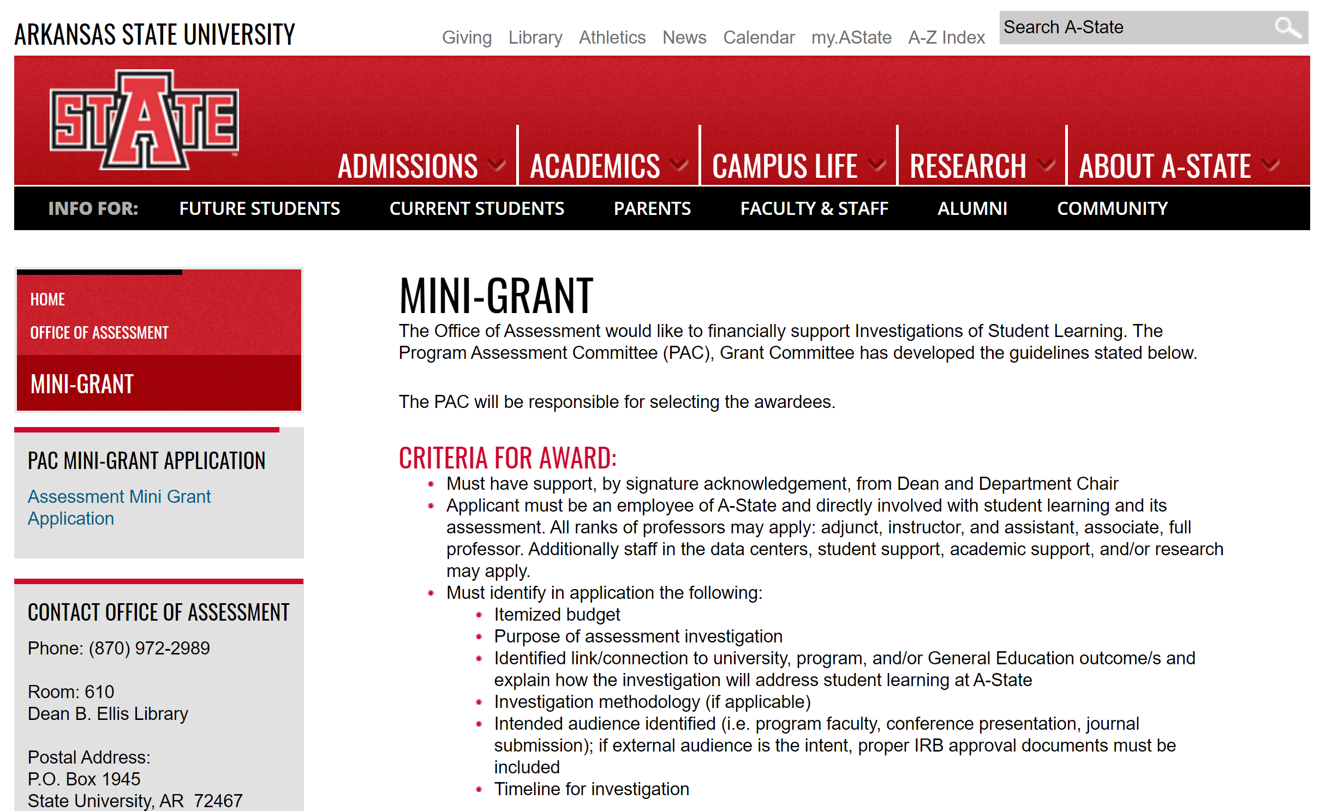
BIG
THANKS

Slide 17
Composition II
Benchmark
Performance
80%
60%
at 2+ (of 4)
at 3 or 4 (of 4)
met in
7 of 8 categories
met in
5 of 8 categories
up from 1 of 4 in Su2018
up from 0 of 4 in Su2018

Slide 18
DECEMBER 2019 COMPOSITION II ASSESSMENT RESULTS
 | 2 or Better | 3 or Better
Experimentation with genre conventions | 94.2% | 65%
Engagement with larger ongoing civic, social, and academic conversations | 100% | 77.8%
Disciplinary and professional research | 99.2% | 75.4%
Understanding of intellectual property, with an emphasis on standardized citation styles | 98% | 71.2%
Revision based on feedback | 69.5% | 51.7%
Metacognition and reflection on writing processes | 91.5% | 59.8%
Effective rhetorical choices regarding grammatical and stylistic conventions | 99.1% | 76.9%

Slide 19
DECEMBER 2019 COMPOSITION II ASSESSMENT RESULTS
 | Krippendorff’s | Cronbach’s
Experimentation with genre conventions | 86% | 92.7%
Engagement with larger ongoing civic, social, and academic conversations | 69.8% | 83.8%
Disciplinary and professional research | 66.8% | 83.9%
Understanding of intellectual property, with an emphasis on standardized citation styles | 78.6% | 86.8%
Revision based on feedback | 91% | 96.1%
Metacognition and reflection on writing processes | 84.2% | 92.8%
Effective rhetorical choices regarding grammatical and stylistic conventions | 64.2% | 79.1%

Slide 20
COHESION
GOOD
WRITING
biggest gains have been in
and shared ideas about

Slide 21
CREDITS
Thanks to the Assessment Office for the generous mini-grant
to the Pilot Curriculum Team
Writing Center Director, Tabatha Simpson-Farrow
Online Writing Center Director, Dr. Airek Beauchamp
Dr. Khem Aryal
Kerri Bennett
Leslie Reed
Skye Roberson
and to these slide template creators:
Presentation template by Slidesgo
Icons by Flaticon
Images & infographics by Freepik
Author introduction slide photo created by Freepik
Text & Image slide photo created by Freepik.com
Big image slide photo created by Freepik.com

